Slide 1
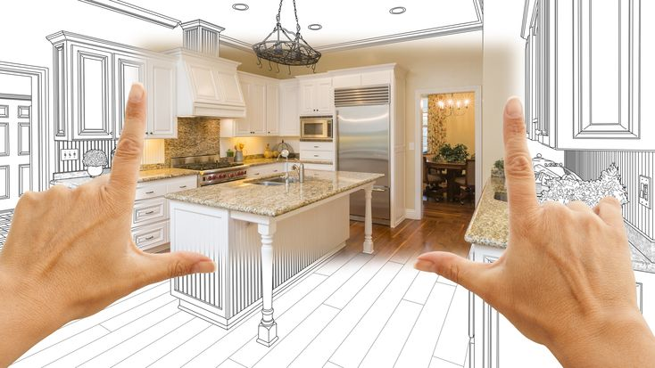
Interior Designers Virtual meet up
team members:
Pushpa - Rashmi - ijaz – Yusuf

Slide 2
Overview
Introduction Interior Designers Virtual Market
Planning Interior Designers Meetup
Agenda of Virtual Meetup
Marketing Efforts
Measuring Success of Event

Slide 3
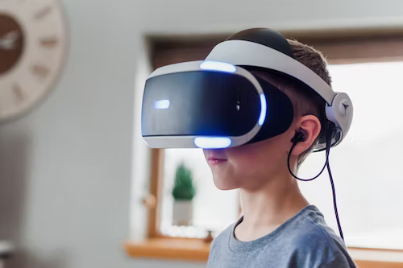
Introduction Interior Designers Virtual Market
Interior design is the art and science of enhancing the interior of a building to achieve a healthier and more aesthetically pleasing environment for the people using the space
Interior design is a multifaceted profession that includes conceptual development, space planning, site inspections, programming, research, communicating with the stakeholders of a project, construction management, and execution of the design.

Slide 4
Planning Interior Designers Meetup
Exhibitors and attendees network and connect among themselves with the live chat tools that are available on a virtual platform
Goals: what we hope to achieve, setting objectives and key performance indicators to measure our event success
Target audience: For whom we are talking to, who are the decision makers and target groups you want to reach.
Virtual events platform: Research virtual platform providers to see which one suits our needs and can translate our requirements.

Slide 5
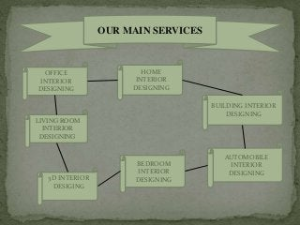
Our main services:

Slide 6
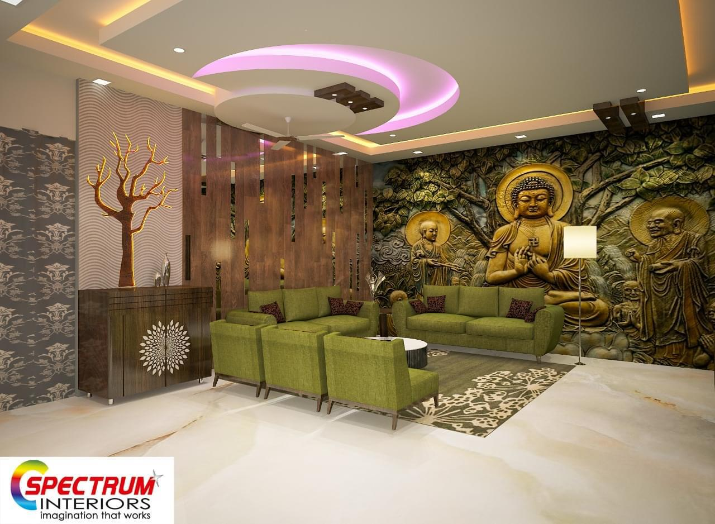
Benefits of Virtual Meetup
1.Better/Clearer presentation
2.Better design visualization
3.Saves time and cost
4.Faster decision making

Slide 7
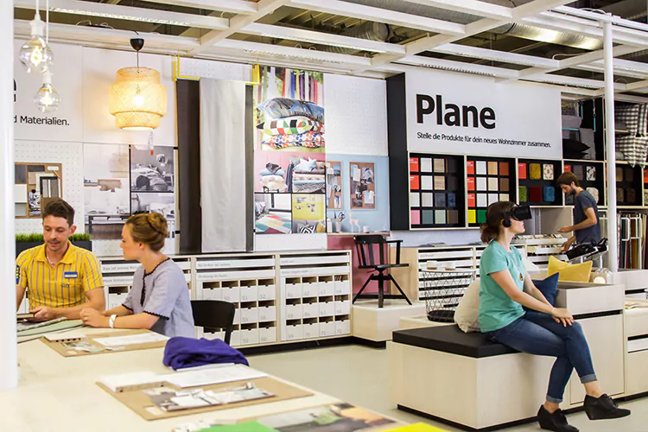
Content marketing
Showroom and simulation
This is the most common use – an experience that allows users to see a product, object, or location up close (and from different angles), interact with it, and sometimes even modify it

Slide 8
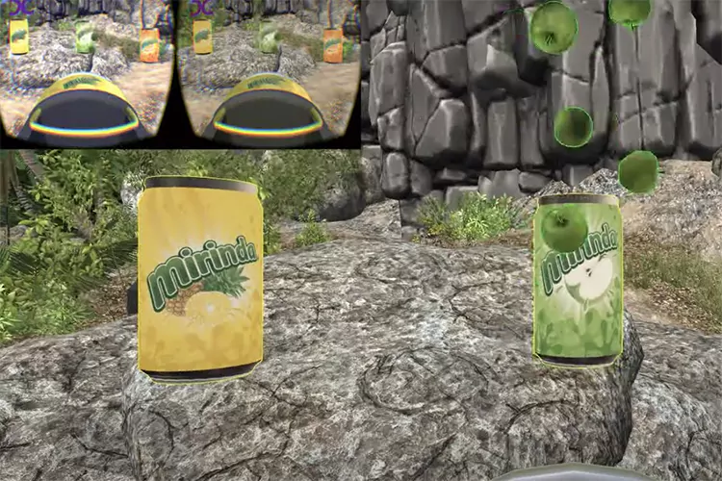
2.Branded games
Branded games can be very effective at raising your brand awareness and familiarizing customers with your product in a fun and pressure-free way. As users focus on gameplay, they are exposed to content representing a company and its products

Slide 9
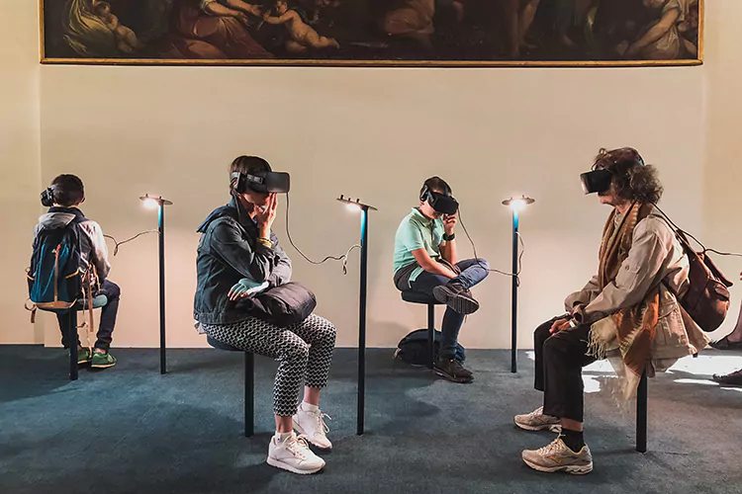
3.Virtual events
A very practical solution in our current era of social distancing. Holding virtual events has become commonplace, with users in any location being able to put on a headset, walk around a digital event hall, see speakers and presentations, and interact with other people

Slide 10
4. VR Advertising
Virtual reality ads are not exactly prevalent yet, but platforms such as Oculus are already testing how they can be implemented. Until a platform-wide ad system is implemented, you can still add VR branded content and custom ads to your immersive app
5.Content marketing
VR in content marketing is effective because the technology happens to be one of the best visualization tools available. 3D models, images, animation, and even text become much more interesting and understandable when you present them in a headset

Slide 11
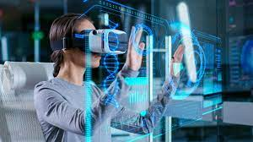
Measuring Success of Event
By knowing audience
Creating a human experience
By working with VR pro
By publishing VR Campaign online

Slide 12
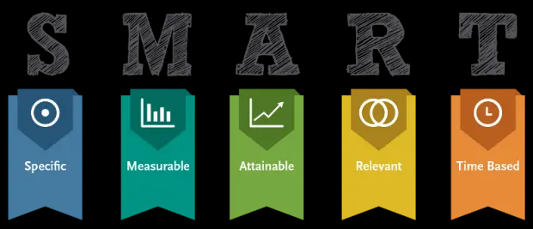
How will you measure success
1.Setting up clear goals from the start
2.By choosing the right platform to host our virtual event
3.By choosing the right time for the event
4.Develop a clear agenda that includes speakers and timeframes
5.By including moderators at our event
6.By engaging audience
7.Prepare to troubleshoot
8.Send out a post-event follow up

Slide 13
Thank you

